Slide 1
CHARITY & PHILANTHROPY
Imran Ahmad Sajid, PhD

Slide 2
Both words are nouns describing the act of helping or goodwill to people.
They are also defined as an act or a gift of supporting or of distributing funds to help others.

Slide 3
Urdu alternatives for….
Charity = خیرات، صدقہ، سخاوت، احسان، زکوٰۃ
Philanthropy = بشر دوستی، انسان دوستی، ہمدردی، خدمتِ خلق
http://www.urduenglishdictionary.org

Slide 4
charity’s Latin roots and philanthropy’s Greek roots are both based on meanings of
  loving-kindness or generosity which are not necessarily the associations we have with these words today.
Source: How Matters (@intldogooder) on November 29, 2011 at 8:41 am :

Slide 5
PHILANTHROPY
Philanthropy is from Greek Philanthropos-- combination of two words:
Philos→ "loving" in the sense of benefitting, caring for, nourishing;
Anthropos → "human being" in the sense of "humanity", or "human-ness"

Slide 6
Philanthropy
Definition
1.desire to benefit humanity: a desire to improve the material, social, and spiritual welfare of humanity, especially through charitable activities
2. love for all humanity: general love for, or benevolence toward, the whole of humankind
3. Philanthropy is "private initiatives, for public good, focusing on quality of life".
Business: private initiatives for private good, focusing on material prosperity

Slide 7
CHARITY
“Charity” is from Latin “caritas”
caritas meant preciousness, dearness, high price
Caritas was translated as agape in Greek →meaning an unconditional love for others
  selfless, altruistic, generous, love;
Source: George McCully — Catalogue for Philanthropy on November 29, 2011 at 3:23 pm

Slide 8
Charity
Definition
Charity is the voluntary giving of help to those in need.
Or,
The voluntary provision of money, materials, or help to people in need.

Slide 9
Welfare
efforts, especially on the part of government and institutions, to ensure that the physical, social, and financial conditions under which people live are satisfactory
Welfare is not an individual act. It is organized act or it is institutionalized act.

Slide 10
act of helping or goodwill to people.
Charity
Philanthropy

Slide 11
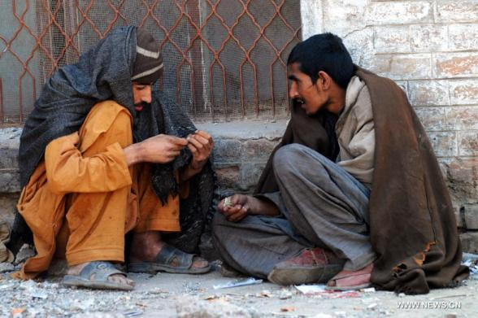
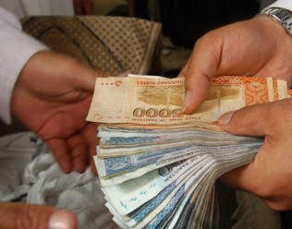
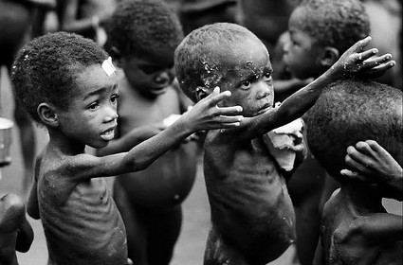
Charity
Philanthropy
Charity addresses the symptoms or pain of social problems.
Philanthropy addresses the causes, of social problems.
Notes:
Giving food to hungry is Charity… eliminating causes of hunger is philanthropy..
Giving protection to a runaway lady is charity….. Eliminating causes of running away from family is philanthropy (parenting skills training)

Slide 12

Charity
Philanthropy
Charity tends to be a short-term.
philanthropy is much more long-term.

Slide 13
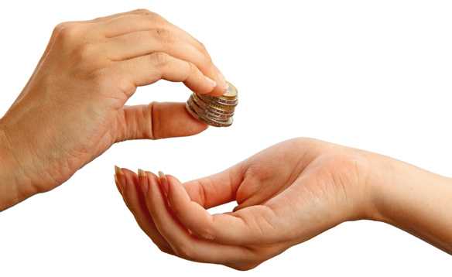
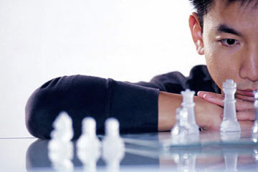
Charity
Philanthropy
Charity is emotional, immediate response
Philanthropy is strategic
Strategic: carefully devised plan of action to achieve a goal

Slide 14
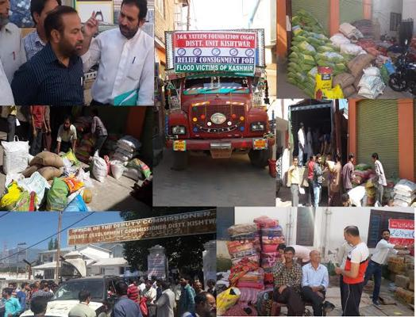

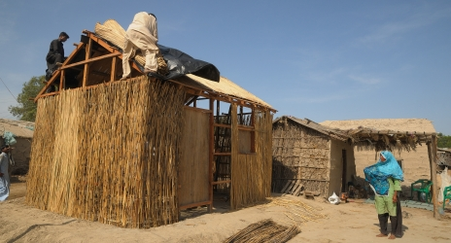
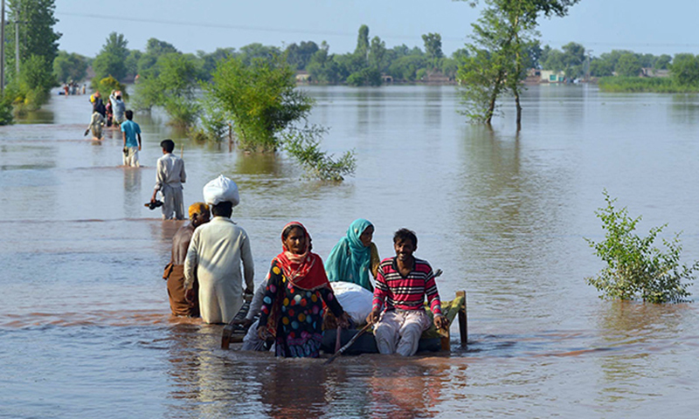

Charity
Philanthropy
Charity is focused on rescue and relief
Philanthropy is focused on rebuilding

Slide 15
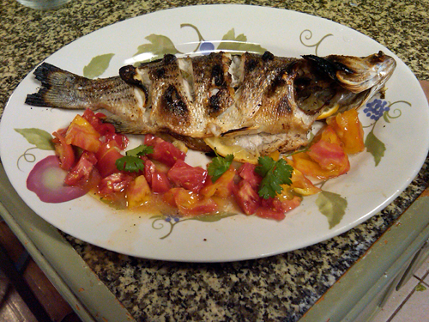
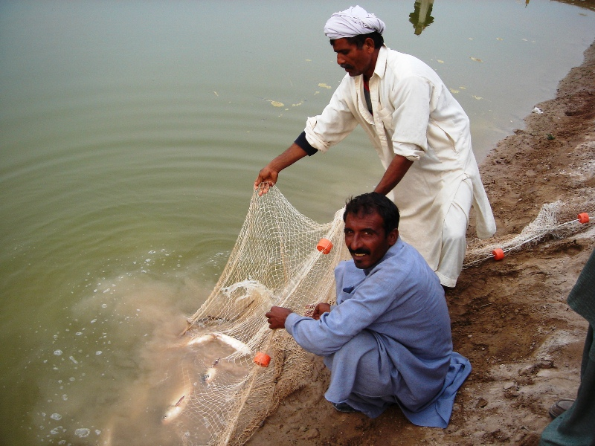
Charity
Philanthropy
charity is giving a man a fish,
philanthropy is teaching him how to fish.

Slide 16
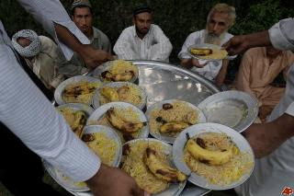
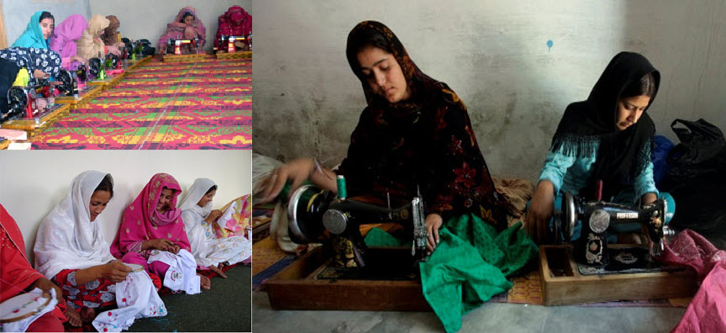
Charity
Philanthropy
charity creates an established, dependent relationship between the giver and the receiver,
Philanthropy seeks to empower and enable sustainability.
Sustainable: Able to maintain

Slide 17


Charity
Philanthropy
Charity is a band-aid
Philanthropy is the medicine

Slide 18
Charity
Philanthropy
Charity is the personal and direct connection to those in need.
Philanthropy is the more institutional, “big-picture” cousin of charity.
Philanthropy does not necessarily imply a personal connection with the needy person--though it can and sometimes does.

Slide 19
The biggest difference often lies in how they are perceived by individuals in the community.
CHARITY is often thought to be helping someone or something right now by giving directly to solve the problem, not necessarily through financial contributions.
It could be direct aid and is generally aimed toward the needy or suffering.
PHILANTHROPY, is love of humankind, the act of improving the situation of others through charitable aid or donations.
Individuals often state that philanthropy in their opinion is long term, whereas charity is immediate and often short term in focus.

Slide 20
Difference
 | Charity | Philanthropy
1 | “Charity” in Latin was “caritas”; The Greek for “caritas” was agapé—selfless, altruistic, generous, love; | the Latin for “philanthropía” was “humanitas”. “philanthropía” meant the “love of what it is to be human”—i.e., the caring for, nurturing, developing, all the attributes of our humanity, our humane-ness.
2 | charity addresses the symptoms, | philanthropy addresses the causes, of social problems.
3 | Charity tends to be a short-term, | philanthropy is much more long-term,
4 | Charity is emotional, immediate response | Philanthropy is strategic
5 | Charity is focused on rescue and relief | Philanthropy is focused on rebuilding
6 | Charity is good | Problem-solving charity is better

Slide 21
 | Charity | Philanthropy
7 | charity is essential to address immediate needs | Philanthropy is building a well for a remote village in East Africa. Philanthropy is changing hearts and minds and cultures, it’s righting wrongs, it’s making the world a better place
8 | Charity is giving… | philanthropy is doing
9 | charity is giving a man a fish, | philanthropy is teaching him how to fish.
10 | charity creates an established, dependent relationship between the giver and the receiver, | Philanthropy seeks to empower and enable sustainability.
11 | Charity is a band-aid | Philanthropy is the medicine
12 | Charity is often thought to be helping someone or something right now by giving directly to solve the problem, not necessarily through financial contributions. It could be direct aid and is generally aimed toward the needy or suffering. | Philanthropy is love of humankind, the act of improving the situation of others through charitable aid or donations.
13 | Charity is the personal and direct connection to those in need. | Philanthropy is the more institutional, “big-picture” cousin of charity. Philanthropy does not necessarily imply a personal connection with the needy person--though it can and sometimes does.

Slide 22
Q/A

